Slide 1
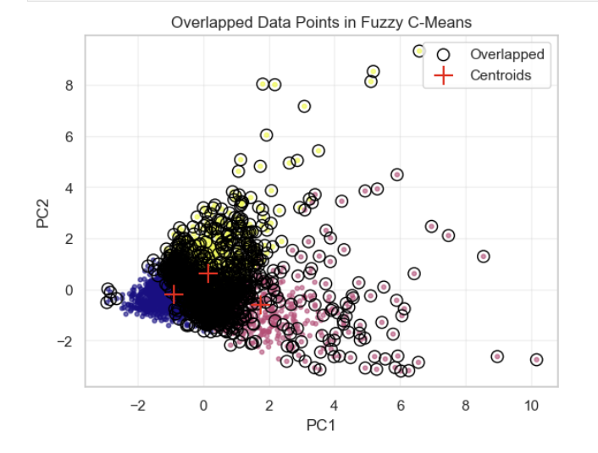
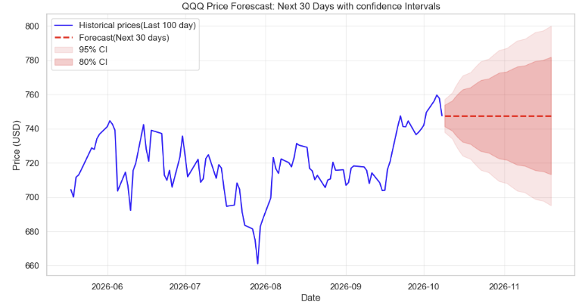
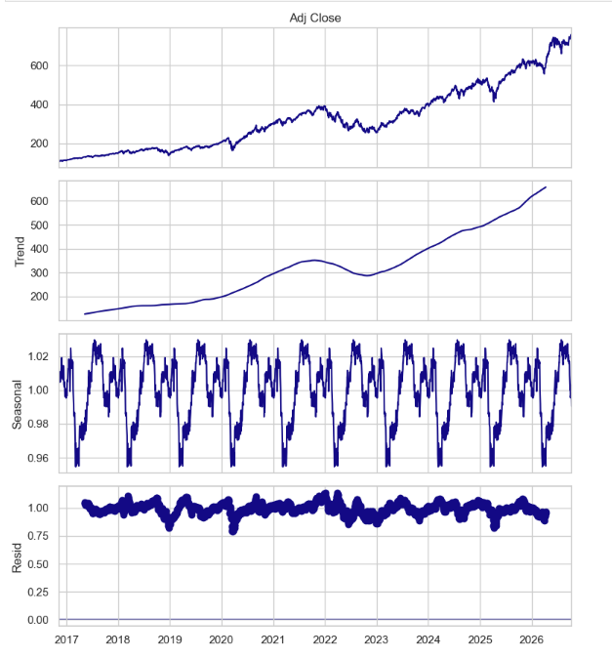
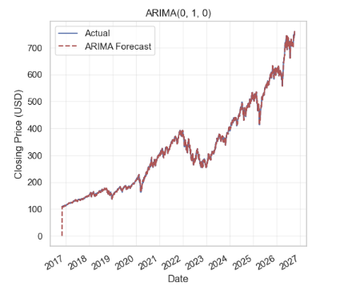
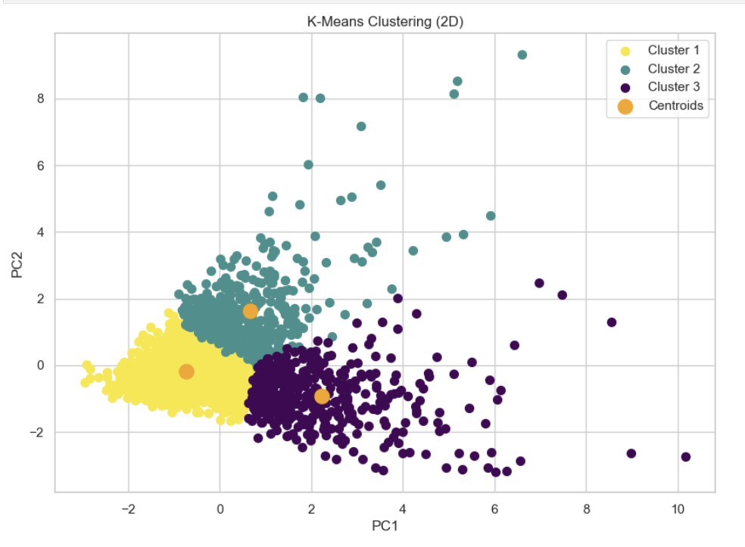
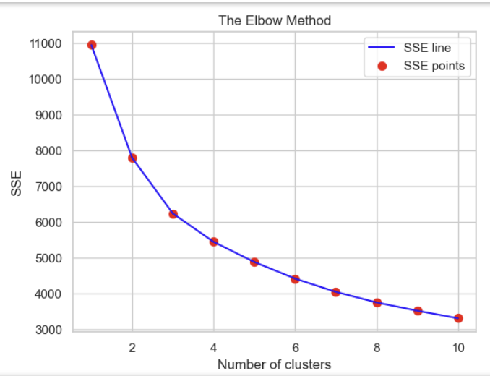
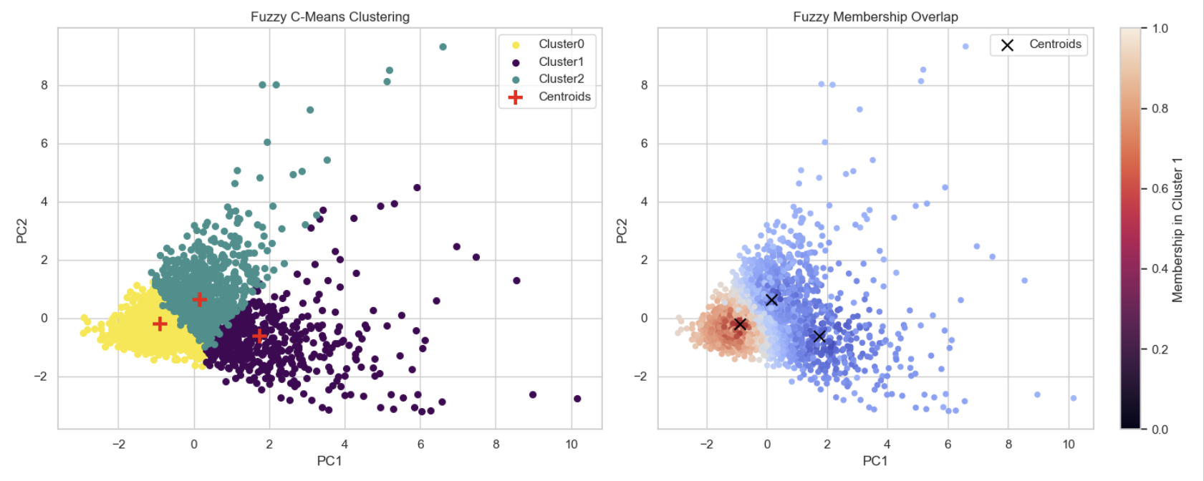
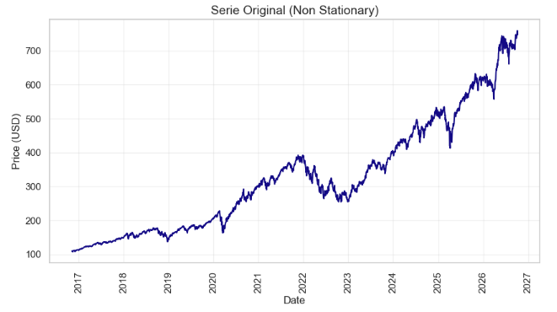
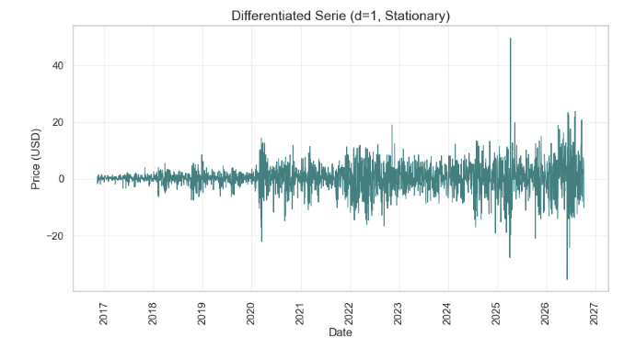
Segmenting Trading Days and Forecasting Market Risk: A machine Learning Approach on QQQ.
Mayra Alejandra Lugo Caicedo 2026119
CCT COLLEGE
INTRODUCTION
METHODS
RESULTS
RESULTS
Financial markets are dynamic, and trading days are not all the same; They go through periods of calm, high volatility and extreme shock. The key thing is to be able to identify what regime the market is in at any time market regime is crucial for risk management. However, this information is not explicitly available in financial data, requiring mathematical models to uncover it. This project applies unsupervised Machine Learning to 10 years of QQQ ETF data to segment trading days into three distinct regimes using K-Means and Fuzzy C-Means, It then uses an ARIMA model to forecast the short-term price. The analysis is based on daily prices, volume, log returns, 20-day volatility, and volume ratio.
Fuzzy C-Means (FCM): Applied to identify "overlapping days" (days where the market did not clearly belong to a single regime).
4. Time Series Forecasting
Finally, the objective was to estimate future price movements based on historical behavior.
Stationarity: ADF and KPSS tests were applied, which confirmed the need for first-order differencing (d=1).
ARIMA(0,1,0): Trained on the first 2,463 days and evaluated on the last 30 days using MAE, RMSE, and MAPE.
Early Warning Signals: These days represent periods where the market transitions between regimes, which is highly valuable for anticipating risk shifts.
3. Time Series Forecasting (ARIMA)
Time Series Decomposition The QQQ price was decomposed to understand its underlying structure (using a multiplicative model):
Trend: Reveals the steady, long-term upward path of the QQQ from 2017 to 2026.
Seasonality: Catches the yearly ups and downs that repeat every 252 trading days.
Residuals: Points out the unpredictable shocks, like the 2020 COVID crash, that do not fit the normal trend.
Stationarity Transformation (d=1)
To use the ARIMA model, the data must be stationary (constant mean and variance).
Original Series (Top): The raw QQQ price is non-stationary, showing a strong long-term trend.
Differentiated Series (Bottom): Applying first order differencing (d=1) successfully removes the trend. The data now oscillates around zero, stabilizing the mean.
ARIMA Forecast: Next 30 Days
Flat Forecast (Red line): The model predicts a flat line because it acts as a Random Walk (the best guess for tomorrow is today's price).
Widening Intervals (Pink areas): The uncertainty grows over time. By day 30, the price could realistically be anywhere between ~$695 and ~$800.
Historical Model Fit: Actual vs. ARIMA (10 Years)
Almost a perfect match: The predicted line (red) fits the actual prices (blue) almost exactly, which explains the very high R² score (0.9991).
The important detail: The model is not actually predicting the future; it is a Random Walk that simply uses yesterday's price to estimate today's. This is why the lines overlap so closely.
OBJECTIVES
Data Preparation
2. Dimensionality
Reduction
Segment the market: Use K-Means and Fuzzy C-Means to divide 10 years of QQQ trading days into three different trading patterns.
Forecast prices: Apply an ARIMA(0,1,0) model to estimate where short-term prices are heading based on historical data.
Integrate both models: Bring together the clustering and forecasting results to give a complete picture of market regimes, transition days, and future price trends.
4. Time Series Forecasting
3. Unsupervised Clustering
METHODS
RESULTS
The ARIMA model is excellent at
following historical trends, but it cannot anticipate sudden market shocks. Size of train Data: 2463
Size of test Data: 30
Size of Pronostic: 30
Pronostic Evaluation (last 30 days):
MAE: 19.44 USD
RMSE: 24.99 USD
MAPE: 2.62%
Data Preparation
To ensure all variables carried the same weight in the analysis, the dataset was first cleaned and standardized.
Dataset: 10 years of daily QQQ ETF historical data.
Variables:
- Adjusted closing prices,
- Trading volume,
- Log returns
- 20-day volatility,
- Volume ratio.
Scaling: Applied RobustScaler to handle extreme market outliers without losing information.
2. Dimensionality Reduction
The analysis involved five different variables, requiring a method to visualize the data in a 2D space.
PCA (Principal Component Analysis) was applied with a 98% variance threshold to retain the maximum amount of information. The data was then reduced to 2 main components for 2D visualization (retaining 74% of the variance).
3. Unsupervised Clustering
The core of the project was to uncover hidden market patterns without using predefined labels.
K-Means: The Elbow Method was used to determine the optimal number of clusters (k=3). The model was validated using Silhouette and Davies-Bouldin scores.
1. Market Segmentation (K-Means)
Three distinct regimes were successfully identified: Normal, High Volatility, and Volume Shock.
Visual Evidence: The 2D PCA scatter plot shows a clear separation between these three market states.
Model Performance: K-Means proved to be the most reliable model for strict classification (Silhouette Score: 0.36, Davies-Bouldin: 1.21).
2. Fuzzy C-Means & Transition Days
Market Ambiguity: Fuzzy C-Means revealed that almost half of the dataset (1,077 days) were "overlapping days".
CONCLUTIONS
The main objective of this project was to segment QQQ trading days according to their behaviour using unsupervised learning and time series analysis, the following conclusions can be drawn:
Market Regimes Exist: I identified 3 distinct market regimes:
Normal Regime: Low Volatility and average volume.
High Volatility Regime: market stress.
Volume Shock Regime: Extreme trading activity.
2. K means is the best model for strict Classification: Kmeans provide to be more effective than Fuzzy C means for clear segmentation with 0.36 and lower Davies Bouldin score 1.21 Fuzzy C-Means: it reveals the market ambiguity.
3. The market does not jump from calm to panic instantly: it has mixed behaviour.
4. ARIMA provides Short Term Accuracy because it showed a high accurate forecast a MAPE of 2,62%, however, the (0,1,0) a Random Walk cannot predict sudden market shocks. While it is impossible to predict the exact future price, understanding the market regime and detecting transition days allows for smarter, data-driven risk management.
REFERENCES
@YahooFinance. (2019). NASDAQ Composite (^IXIC) Stock Price, Quote, History & News. [online] Available at: https://finance.yahoo.com/quote/%5EIXIC/ [Accessed 29 Sept. 2026].
Iqbal, M. (2026) 'Tutorial 6 (ARIMA and SARIMA)', MLBus_HDipData_Feb26_FT: Machine Learning for Business. Dublin: CCT College Dublin.
Abu Summaqa, Y. (2026). What is volatility in trading? volatility trading for beginners. [online] Equiti Default. Available at: https://www.equiti.com/sc-en/news/trading-ideas/what-is-volatility-in-trading-volatility-trading-for-beginners/

